Slide 1




REST Controllers and Routing
Controllers, Routes, Responses
PHP MVC Frameworks
Veselin Malezanov
Technical Trainers
Software University
http://softuni.bg

Slide 2


Table of Contents
Controller
Routing
Request and Response
REST

Slide 3
Have a question?
#sli.do
#PHP-WEB

Slide 4


Controller
Control, Control, You Must Learn Control

Slide 5

Controller
Only concerned with Controlling
Not responsible for the doing
Takes care of web specific stuff
like authentication, cookies
request variables, query string

Slide 6
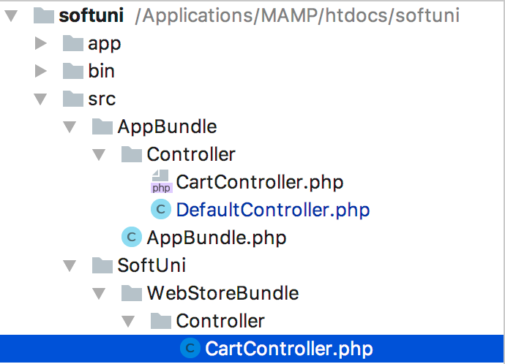
Controller
Location: src/SomeNameBundle/Controller directory

Slide 7
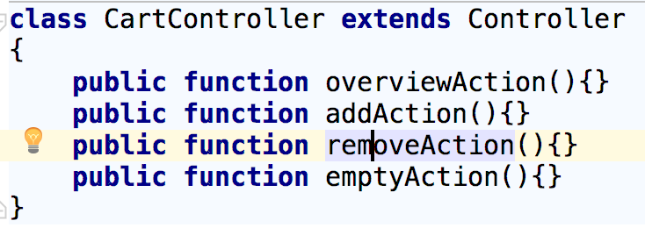
Controller
Controller names should end with "Controller"
Controller action names should end with "Action"

Slide 8
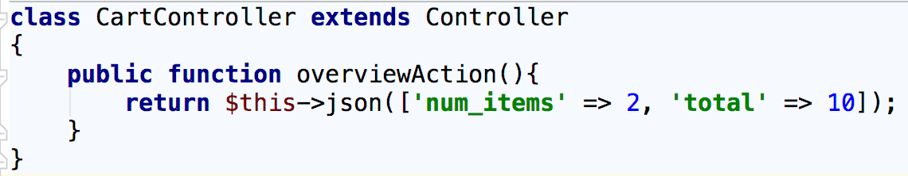
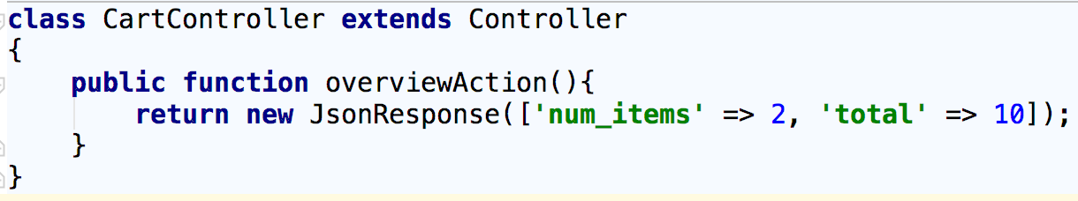
Controller
Must always return Response:
5-10-20 rule:
5 or less class variables
10 or less actions
20 or less lines of code for each action

Slide 9
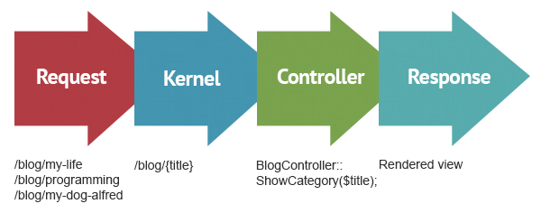
Controller
Requests, Controller, Response Lifecycle

Slide 10
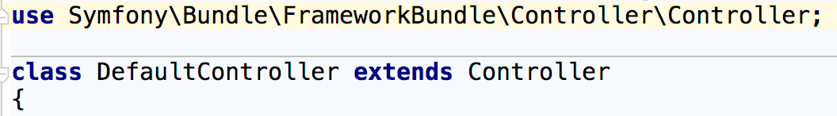
Controller
Symfony’s Base Controller
Provides access to helper methods and the service container
Won’t change your controller workflow

Slide 11
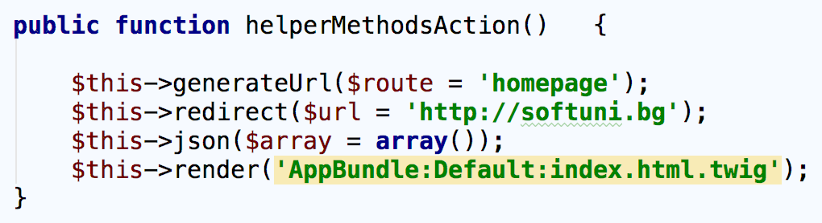
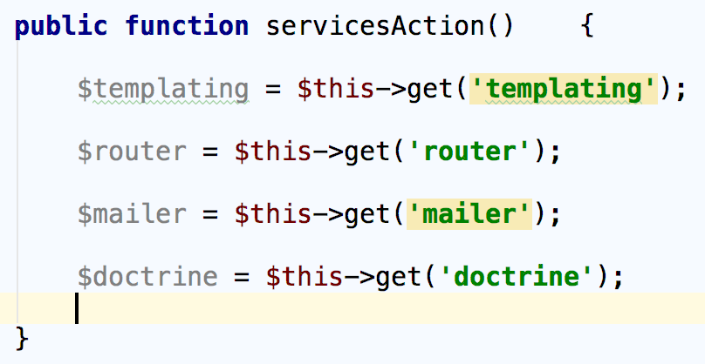
Controller
Symfony’s Base Controller - helper methods example
Symfony’s Base Controller - services example

Slide 12
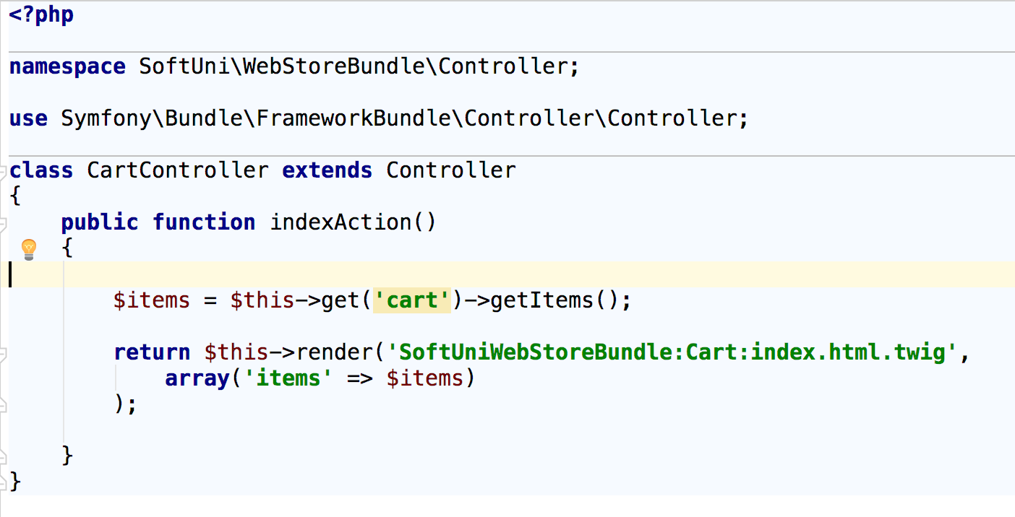
Controller
Example

Slide 13
Problem 1: Create New Controller

Slide 14

Routing
Routes and Mapping to Controller

Slide 15
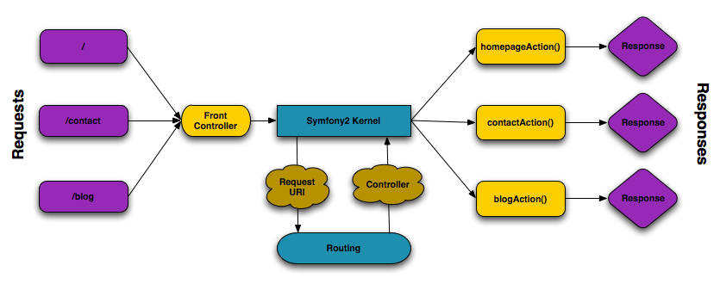
Routing
Process of breaking the URL into components and deciding what script to call

Slide 16
Routing
Four ways to define routes:
Annotations
YAML
XML
PHP
Only one type of configuration is allowed
No difference in execution time

Slide 17
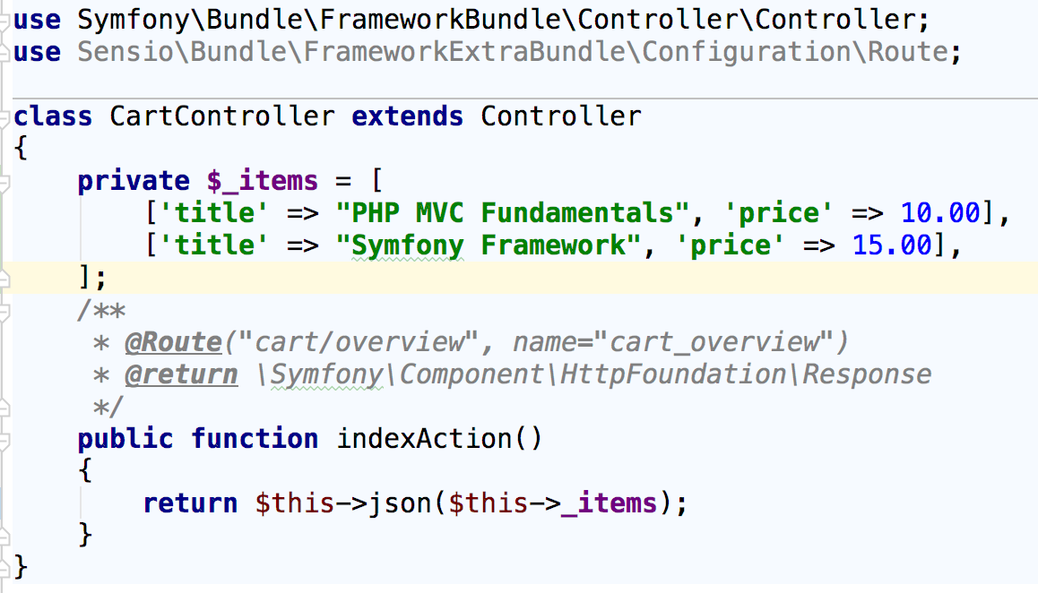
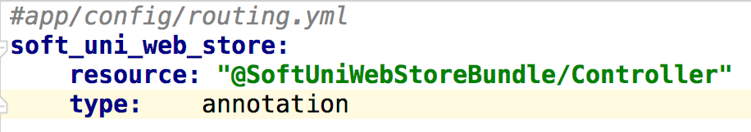
Routing
Annotation: @Route

Slide 18
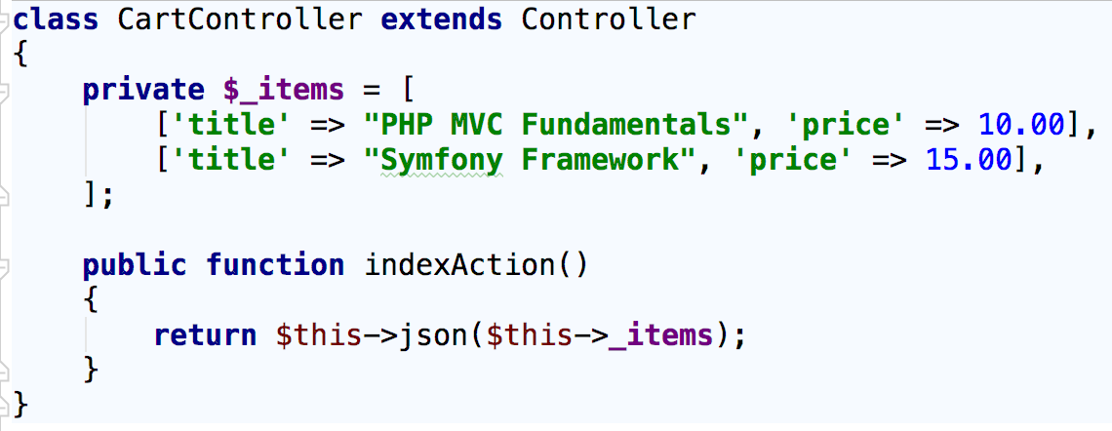
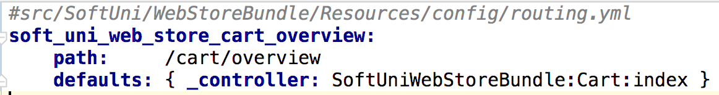
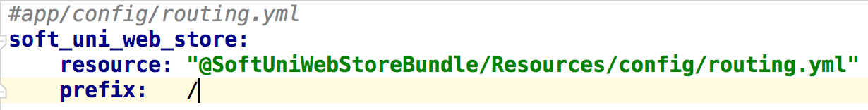
Routing
YAML

Slide 19
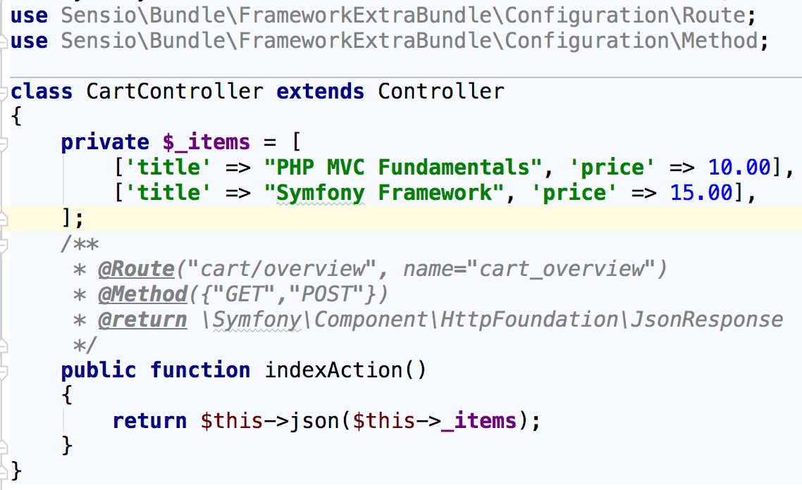
Routing
Configure different HTTP methods for the route
Annotation: @Method

Slide 20
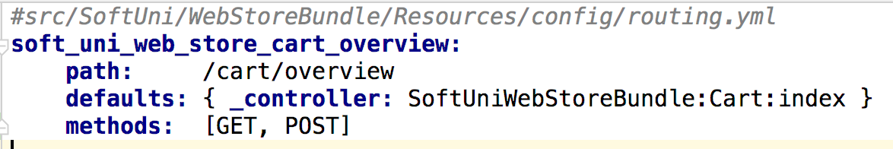
Routing
Configure different HTTP methods for the route
YAML

Slide 21
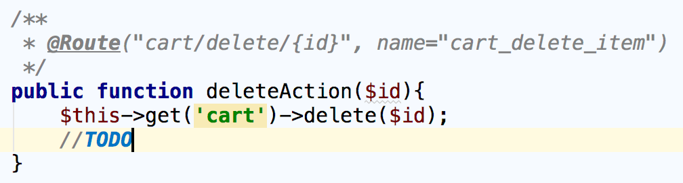
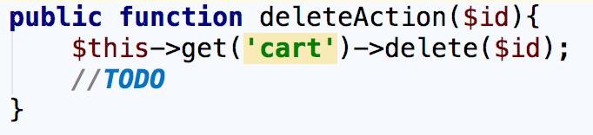
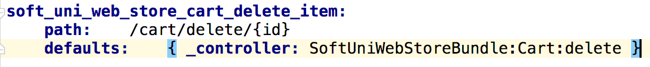
Routing
Route Parameters
Annotation
YAML

Slide 22
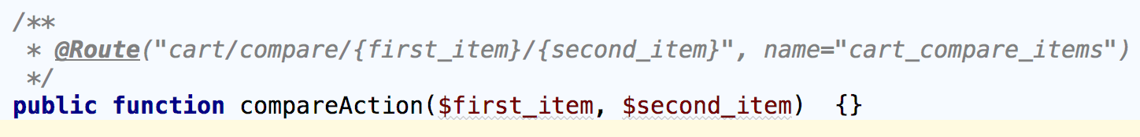
Routing
Route Parameters
Additional parameters are converted to query parameters
Parameters names passed to the controller must match route parameters names
Parameters and route parameters names must be the same

Slide 23
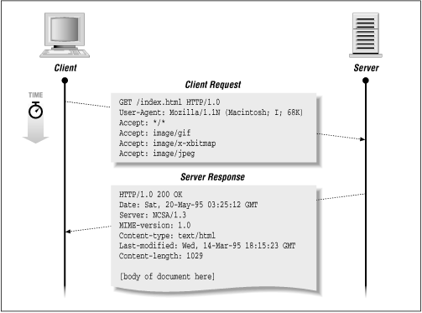
Request & Response

Slide 24
Request & Response
Symfony Application Lifecycle

Slide 25
Request & Response
Symfony Application Lifecycle
Client sends an HTTP Request
For each request the front controller is executed Index file (app.php or app_dev.php)
Router component matches the request and execute controller
Response object is returned

Slide 26

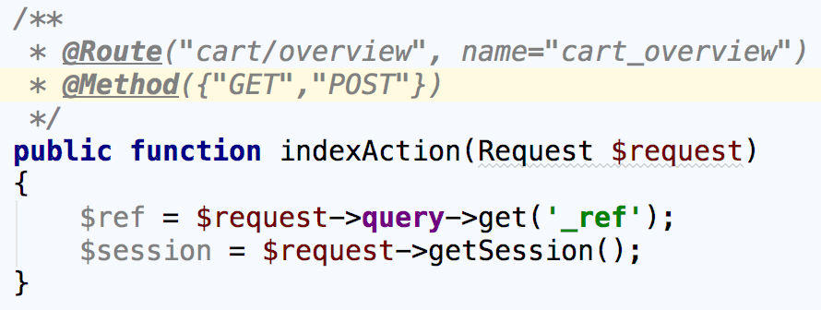
Request & Response
Request
Import the Request Object in controller class
To use it in your controller type-hint it with the Request class

Slide 27
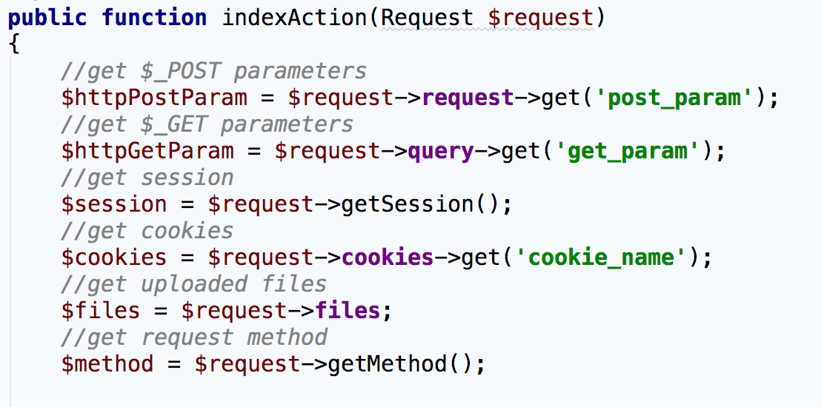
Request & Response
Request Examples:

Slide 28

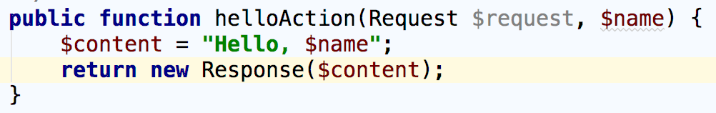
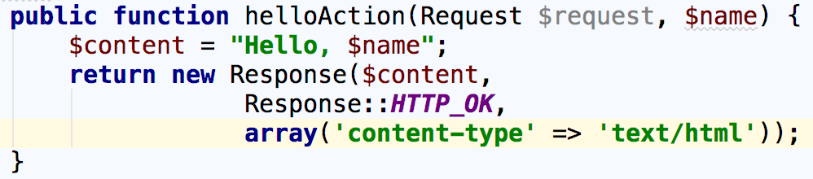
Request & Response
Response
Import the Response Object in controller class

Slide 29

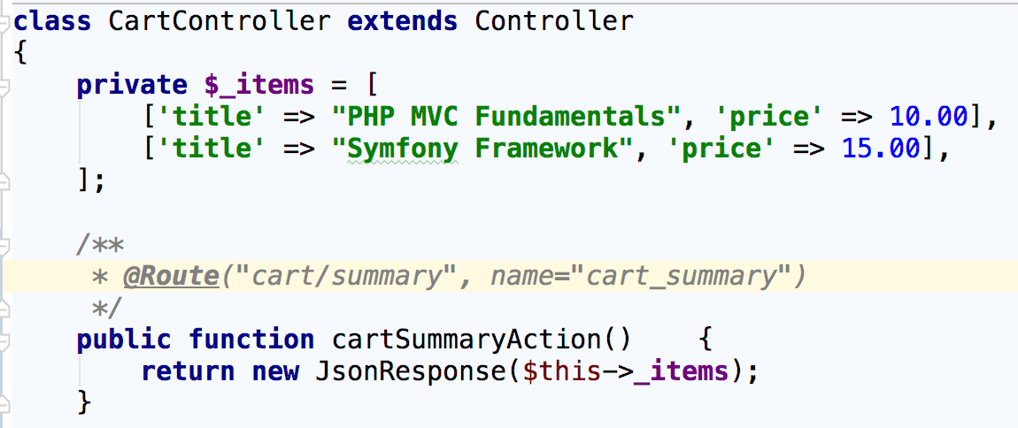
Request & Response
JsonResponse

Slide 30
Request & Response
Response Content-Types
json - application/json
xml - application/xml
png image - image/png
html - text/html
full list of content types: developer.mozilla.org

Slide 31
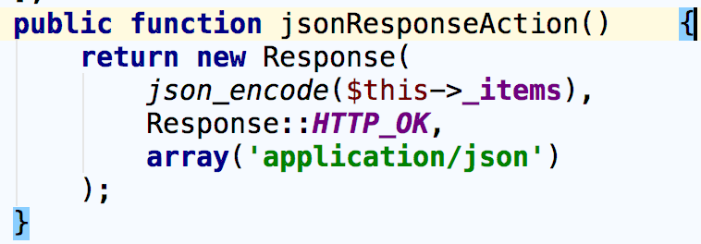
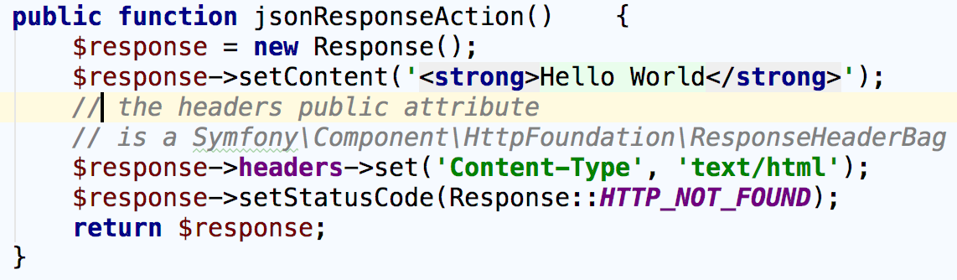
Request & Response
Set Conten-type Examples

Slide 32
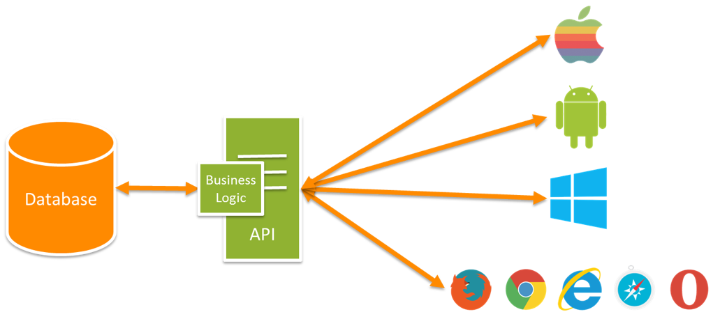
REST
What is REST?
REpresentational State Transfer
Interface from one program to another
REST is stateless
REST is resource based

Slide 33
REST
REST & HTTP
Request methods:
GET - Get resource
POST - Create resource
PUT - Update resource
PATCH - Partly update resource
DELETE - Delete resource
HEAD - Get headers for resource
Response: json, xml

Slide 34
REST
REST URLs
GET - HTTP://MYSITE.COM/API/USERS
GET - HTTP://MYSITE.COM/API/USERS/1
POST - HTTP://MYSITE.COM/API/USERS
PUT - HTTP://MYSITE.COM/API/USERS/1
DELETE - HTTP://MYSITE.COM/API/USERS/1

Slide 35
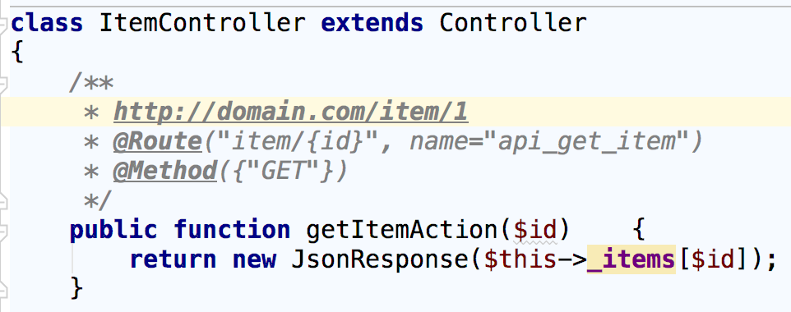
REST
REST Controllers
A Symfony controller configured for specific http method

Slide 36
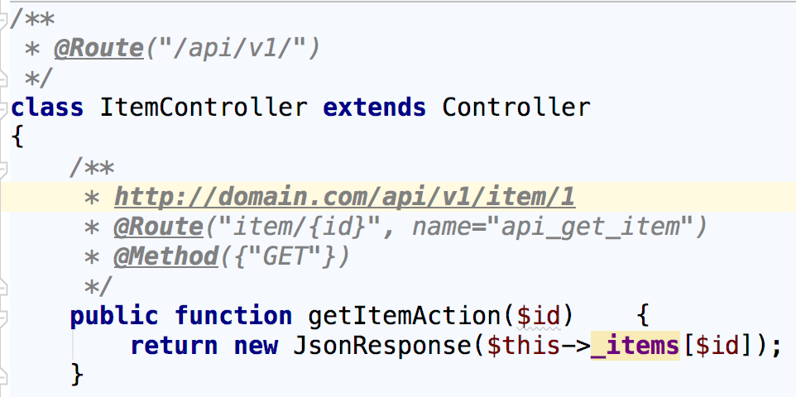
REST
REST Controllers
Add prefix to your controller using the @Route annotation

Slide 37
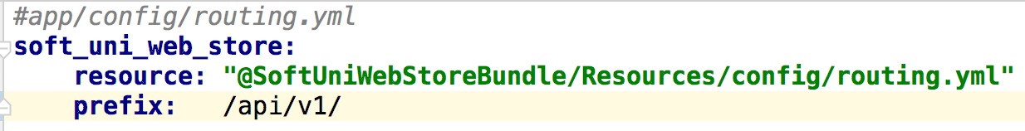
REST
REST Controllers
Prefix with YAML

Slide 38
Summary
Controllers - Create controllers, actions, 5-10-20 rule
Routing - Define routes, configuration, route parameters
Request & Response - Request methods, Response types
REST - Rest concepts, REST URIs, Responses

Slide 39
REST Controllers and Routing
https://softuni.bg/courses/

Slide 40
License
This course (slides, examples, demos, videos, homework, etc.) is licensed under the "Creative Commons Attribution-NonCommercial-ShareAlike 4.0 International" license

Slide 41



Trainings @ Software University (SoftUni)
Software University – High-Quality Education, Profession and Job for Software Developers
softuni.bg
Software University Foundation
softuni.org
Software University @ Facebook
facebook.com/SoftwareUniversity
Software University Forums
forum.softuni.bg

Slide 42
License
This course (slides, examples, demos, videos, homework, etc.) is licensed under the "Creative Commons Attribution-NonCommercial-ShareAlike 4.0 International" license

Slide 43
Trainings @ Software University (SoftUni)
Software University – High-Quality Education, Profession and Job for Software Developers
softuni.bg
Software University Foundation
softuni.org
Software University @ Facebook
facebook.com/SoftwareUniversity
Software University Forums
forum.softuni.bg

